Slide 1
2.2 Pointers
<number>
Department of CSE

Slide 2
Objectives
To understand the need and application of pointers
To learn how to declare a pointer and how it is represented in memory
To learn the relation between arrays and pointers
To study the need for call-by-reference
To distinguish between some special types of pointers
2
Department of CSE

Slide 3
Agenda
Basics of Pointers
Declaration and Memory Representation
Operators associated with pointers
address of operator
dereferencing operator
Arrays and Pointers.
Compatibility of pointers
Functions and Pointers
Special types of pointers
void pointer
null pointer
constant pointers
dangling pointers
pointer to pointer
3
Department of CSE

Slide 4
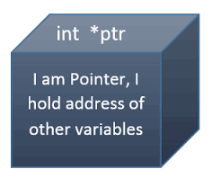
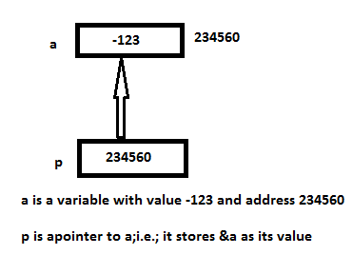

Introduction
A pointer is defined as a variable whose value is the address of another variable.
It is mandatory to declare a pointer before using it to store any variable address.
4
Department of CSE

Slide 5
Pointer Declaration
General form of a pointer variable declaration:-
datatype *ptrname;
Eg:-
int *p; (p is a pointer that can point only integer variables)
float *fp; (fp can point only floating-point variables)
Actual data type of the value of all pointers is a long hexadecimal number that represents a memory address
5
Department of CSE

Slide 6
Initialization of Pointer Variable
Uninitialized pointers will have some unknown memory address in them.
Initialize/ Assign a valid memory address to the pointer.
The variable should be defined before pointer.
Initializing pointer to NULL
int *p = NULL;
Initialization | Assignment
int a; int *p = &a; | int a; int *p; p = &a;
6
Department of CSE

Slide 7
Why Pointers?
Manages memory more efficiently.
Leads to more compact and efficient code than that can be obtained in other ways
One way to have a function modify the actual value of a variable passed to it.
Helps to dynamically allocate memory when the exact amount of memory required is not known in the beginning.
7
Department of CSE

Slide 8
Referencing/ “Address of” operator
To make a pointer point to another variable, it is necessary to obtain the memory address of that variable.
To get the memory address of a variable (its location in memory), put the & sign in front of the variable name.
& is called the address-of operator, because it returns the memory address. It’s a unary operator.
It is also known as Referencing operator as it refers/points to another variable of same data type.
8
Department of CSE

Slide 9
Dereferencing/Indirection Operator
It’s a unary operator - *
‘*’ is followed by the pointer name, say p ; i.e.; *p.
It looks at the address stored in p, and goes to that address and returns the value.
This is akin to looking inside a safety deposit box only to find the number of (and, presumably, the key to ) another box, which you then open.
9
Department of CSE

Slide 10
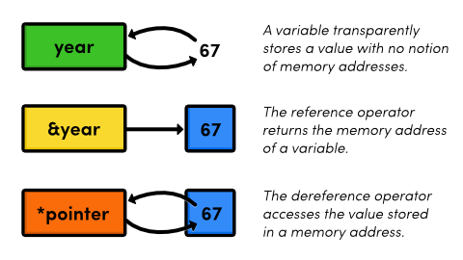
Referencing & Dereferencing Operators
9
Department of CSE

Slide 11
Sample Code -1 : Simple Pointer
#include<stdio.h>
int main()
{
int x=10;
int *ip;
ip=&x;
printf("Number : %d\n",x);
printf("Address: %p\n",(&x));
printf("Number using pointer : %d\n", *ip);
printf("Address using Pointer: %p\n",ip);
return 0;
}
Output:-
Number : 10
Address: 0x7fff4fab3044
Number using pointer : 10
Address using Pointer: 0x7fff4fab3044
11
Department of CSE

Slide 12
Sample Code -2 : Pointers to different types
#include<stdio.h>
int main()
{
int x=10;
int *ip;
float y=2.5, *fp;
fp = &y;
ip=&x;
printf("Number using pointer : %d\n", *ip);
printf("Address using Pointer: %p\n",ip);
printf("Decimal value : %f\n",*fp);
printf("Address of y : %p\n",fp);
return 0;
}
Output:-
Number using pointer : 10
Address using Pointer: 0x7fff4f5c31bc
Decimal value : 2.500000
Address of y : 0x7fff4f5c31b8
12
Department of CSE

Slide 13
Sample Code -3 : Same pointer to multiple variables
#include<stdio.h>
int main()
{
int a,b,c,*p; //a,b and c are variables and p is a pointer
printf("Enter three integers : ");
scanf("%d %d %d",&a,&b,&c);
p = &a;
printf("pointer points to a. Value is %d\n",*p);
p = &b;
printf("pointer points to b. Value is %d\n",*p);
p = &c;
printf("pointer points to c. Value is %d\n",*p);
return 0;
}
Output:-
Enter three integers : 10 20 30
pointer points to a. Value is 10
pointer points to b. Value is 20
pointer points to c. Value is 30
13
Department of CSE

Slide 14
Sample Code -4 : Multiple Pointers to same variable
#include<stdio.h>
int main()
{
int a;
int *p = &a;
int *q = &a;
int *r = &a;
printf("Enter an integer : ");
scanf("%d",&a);
printf("%d\n",*p);
printf("%d\n",*q);
printf("%d\n",*r);
return 0;
}
Output:-
Enter an integer : 15
15
15
15
14
Department of CSE

Slide 15
Pointer and 1D Array
14
Department of CSE

Slide 16
Relationship between array and pointer
The name of array is a pointer to the first element
Address of first element and name of array represent the same memory address.
Array name can be used as a pointer.
When a separate pointer is used to point to an array, it is initialized using the following syntax:-
datatype *ptrname = array_name;
Eg:- int a[5] = {1,2,3,4,5};
int *ptr = a; //Equivalent to writing int *ptr = &a[0];
16
Department of CSE

Slide 17
Sample Program 5 : Pointer and Array I
Output:-
0x7fff03b2d380 0x7fff03b2d380
1 1
#include<stdio.h>
int main()
{
int a[5] = {1,2,3,4,5};
int *p = a;
printf("%p %p\n",&a[0],a);
printf("%d %d\n",*a,*p);
return 0;
}
17
Department of CSE

Slide 18
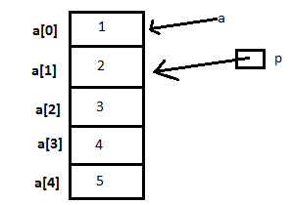
Sample Program 6 : Pointer and Array II
#include<stdio.h>
int main()
{
int a[5] = {1,2,3,4,5};
int *p = &a[1];
printf("First element : %d %d\n",a[0],p[-1]);
printf("Second element:%d %d\n",a[1],p[0]);
return 0;
}
Output:-
First element : 1 1
Second element: 2 2
Note:-When a pointer to an array is not pointing to the first element, index can be negative.
18
Department of CSE
Notes:
<number>

Slide 19
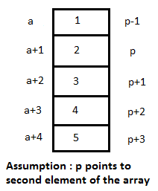
Pointer Arithmetic and 1D Arrays
If ‘a’ is an array name, then ‘a’ points to first element
a+1 points to the second element, a+2 points to third element and so on.
Generally (a+n) points to (n+1)^{th} element.
Similarly, for a pointer p, p±n points to a location which is n elements away from current location.
Actual address will be p+n*(size of one element).
19
Department of CSE

Slide 20
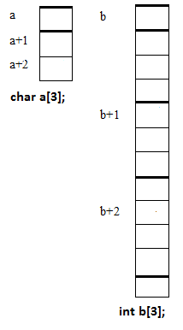
Pointer arithmetic on different data types
Size of single element varies with respect to data type of array.
‘char’ takes one byte per character stored, whereas ‘int’ and ‘float’ takes 4 bytes per value stored.
Hence adding 1 to array name points to different addresses for different data types
19
Department of CSE

Slide 21
Modifying values using pointers
19
Department of CSE

Slide 22
Modifying value using pointer
If ip points to an integer x, *ip can be used in places where x could have been used.
*ip = *ip + 10; will modify the value of x by 10
y = *ip + 1; is equivalent to y = x+1;
*ip += 1 can be written as ++(*ip) or (*ip)++
19
Department of CSE

Slide 23
Sample Code –7: Updating value using Pointer
#include<stdio.h>
int main()
{
int x=10;
int *ip;
float y=2.5, *fp;
fp = &y;
ip=&x;
printf("Number using pointer : %d\n", *ip);
printf("Address using Pointer: %p\n",ip);
printf("Decimal value : %f\n",*fp);
printf("Address of y : %p\n",fp);
x+=1;
printf("Updated Number : %d\n", *ip);
*ip *=5;
printf("Updated Number : %d\n", *ip);
++*ip;
printf("Updated Number : %d\n", *ip);
return 0;
}
Output:-
Number using pointer : 10
Address using Pointer: 0x7fff76d4f8ec
Decimal value : 2.500000
Address of y : 0x7fff76d4f8e8
Updated Number : 11
Updated Number : 55
Updated Number : 56
23
Department of CSE

Slide 24
Sample Code -8 : Adding two numbers using Pointers
#include<stdio.h>
int main()
{
int a=10,b=5,c;
int *p1 = &a;
int *p2 = &b;
int *res = &c;
*res = *p1 + *p2;
printf("%d + %d = %d\n",*p1,*p2,c);
return 0;
}
Output:-
10 + 5 = 15
24
Department of CSE

Slide 25
Pointer to array : Order of placing ‘*’ and ‘++’
Assume that z is an inger array with two values 1 and 2 (int z[2]={1,3};)
Let ip be a pointer to z; (int *ip = z;)
printf("%d\n", ++*ip);
increments content in the address pointed by ip.
z[0]=1 was taken and incremented by 1.
In output the value is 2
Z[0]=2 and z[1]=2
printf("%d\n", *++ip);
increments the address pointed by ip.
ip currently points to z[1]=3
In output the value is 3
Ip address changed from 1 to 2
Then the value to be printed
Order of placing ‘++’ and ‘*’ is crucial
++ followed by * → Value is incremented.
* followed by ++ → Address is incremented.
25
Department of CSE

Slide 26
Sample Code Snippet - 9a – ++ before *
#include<stdio.h>
main()
{
int z[2]={1,3};
int * ip = z;
printf("%p\n",ip);
printf("%d\n", *ip);
printf("%d\n", ++*ip);
printf("%p",ip);
return 0;
}
Sample Output
0x7fff0fc66d30
1
2
0x7fff0fc66d30
26
Department of CSE

Slide 27
Sample Code Snippet -9b : * before ++
#include<stdio.h>
main()
{
int z[2]={1,3};
int * ip = z;
printf("%p\n",ip);
printf("%d\n", *ip);
printf("%d\n", *++ip);
printf("%p",ip);
return 0;
}
Sample Output
0x7ffffc801740
1
3
0x7ffffc801744
27
Department of CSE

Slide 28
Pointer Compatibility
27
Department of CSE

Slide 29
Pointer Compatibility
Pointers have a type associated with them → They can point only to specific type.
Two types:-
Pointer Size Compatibility
Pointer Dereferencing compatibility
27
Department of CSE

Slide 30
Pointer Size Compatibility
Size of all pointers is the same; i.e.; every pointer variable holds the address of one memory location. But the size of variable that the pointer points to can be different.
Size of the type that a pointer points to is same as its data size.
Size is dependent on type; not on the value.
27
Department of CSE

Slide 31
Sample Code -10 : Pointer Size Compatibility
#include<stdio.h>
int main()
{
char c;
char* pc;
int sizeofc = sizeof(c);
int sizeofpc = sizeof(pc);
int sizeofstarpc = sizeof(*pc);
int a;
int* pa;
int sizeofa = sizeof(a);
int sizeofpa = sizeof(pa);
int sizeofstarpa = sizeof(*pa);
double d;
double* pd;
int sizeofd = sizeof(d);
int sizeofpd = sizeof(pd);
int sizeofstarpd = sizeof(*pd);
printf("Size of c : %3d | ",sizeofc);
printf("Size of pc : %3d | ",sizeofpc);
printf("size of *pc : %3d\n",sizeofstarpc);
printf("Size of a : %3d | ",sizeofa);
printf("Size of pa : %3d | ",sizeofpa);
printf("size of *pa : %3d\n",sizeofstarpa);
printf("Size of d : %3d | ",sizeofd);
printf("Size of pd : %3d | ",sizeofpd);
printf("size of *pd : %3d\n",sizeofstarpd);
return 0;
}
Sample Output
Size of c : 1 | Size of pc : 8 | size of *pc : 1
Size of a : 4 | Size of pa : 8 | size of *pa : 4
Size of d : 8 | Size of pd : 8 | size of *pd : 8
31
Department of CSE

Slide 32
Dereferencing Compatibility
Dereference type is the type of variable that the pointer is referencing.
It is usually invalid to assign a pointer of one type to address of a variable of another type.
It is also invalid to assign a pointer of one type to pointer of another type.
Exception : pointer to void (Will be discussed later.)
31
Department of CSE

Slide 33
Sample Code 11: Pointer Dereferencing Incompatibility
#include<stdio.h>
int main()
{
int x=10;
int *ip;
float y=2.5, *fp;
fp = &y;
ip=&x;
printf("Number using pointer : %d\n", *ip);
printf("Address using Pointer: %p\n",ip);
printf("Decimal value : %f\n",*fp);
printf("Address of y : %p\n",fp);
fp = &x;
printf("New value pointed by fp = %f\n",*fp);
return 0;
}
ptrcompat.c: In function ‘main’:
ptrcompat.c:13: warning: assignment from incompatible pointer type
Output:-
Number using pointer : 10
Address using Pointer: 0x7fffda19b6ec
Decimal value : 2.500000
Address of y : 0x7fffda19b6e8
New value pointed by fp = 0.000000
33
Department of CSE

Slide 34
Pointers and Functions
33
Department of CSE

Slide 35
How to swap two numbers using function?
#include<stdio.h>
int main()
{
int a,b;
void swap(int ,int );
printf("Enter first number : " );
scanf("%d",&a);
printf("Enter second number: ");
scanf("%d",&b);
printf("Numbers before function call: %d\t%d\n",a,b);
swap(a,b);
printf("Numbers after function call : %d\t%d\n",a,b);
return 0;
}
Output:-
Enter first number : 5
Enter second number: 10
Numbers before function call: 5 10
Numbers before swapping : 5 10
Numbers after swapping : 10 5
Numbers after function call : 5 10
void swap(int a, int b)
{
int t;
printf("Numbers before swapping : %d\t%d\n",a,b);
t = a;
a = b;
b = t;
printf("Numbers after swapping : %d\t%d\n",a,b);
}
35
Department of CSE

Slide 36
How to swap two numbers using function?
Values are getting interchanged inside the function. But that is not getting reflected in main.
Call-by-value will not interchange numbers.
If you want to modify the actual parameters, you require ‘Call-by-Reference’.
This type of function requires pointers.
36
Department of CSE

Slide 37
How to swap two numbers using function?
#include<stdio.h>
int main()
{
int a,b;
void swap(int *,int *);
printf("Enter first number : " );
scanf("%d",&a);
printf("Enter second number: ");
scanf("%d",&b);
printf("Numbers before function call: %d\t%d\n",a,b);
swap(&a,&b);
printf("Numbers after function call : %d\t%d\n",a,b);
return 0;
}
Output:-
Enter first number : 5
Enter second number: 10
Numbers before function call: 5 10
Numbers before swapping : 5 10
Numbers after swapping : 10 5
Numbers after function call : 10 5
void swap(int *x, int *y)
{
int t;
printf("Numbers before swapping : %d\t%d\n",*x,*y);
t = *x;
*x = *y;
*y = t;
printf("Numbers after swapping : %d\t%d\n",*x,*y);
}
37
Department of CSE

Slide 38
Points to be noted while using Call-by-Reference
 | Call-by-Value | Call-by-Reference
Function Declaration | void swap(int ,int ); | void swap(int *,int *);
Function Header | void swap(int a, int b) | void swap(int *a, int *b)
Function Call | swap(a,b); | swap(&a,&b);
Requires ‘*’ operator along with data type of arguments – in declaration as well as Function header.
Requires ‘&’ along with actual arguments in Function call.
Requires ‘*’ operator inside function body.
38
Department of CSE

Slide 39
When do you need pointers in functions?
First scenario – In Call-by-Reference.
There is a requirement to modify the values of actual arguments.
Second scenario – While passing array as an argument to a function.
Third Scenario - If you need to return multiple values from a function.
38
Department of CSE

Slide 40
Passing array as an argument to a function
When an array is passed as an argument to a function, it is actually passed as reference.
If any modification of array elements is done inside the function, it actually changes the original value stored in the array.
Since modifications affect actual values, array need not be returned from the function.
38
Department of CSE

Slide 41
Sample Code 12 : Passing an array to a function
#include<stdio.h>
int main()
{
int a[5]={1,2,3,4,5};
int i;
//First argumnt is an array and second argument is its size
void square(int *,int);
printf("Array before modification:-\n");
for(i=0;i<5;i++)
printf("%d\t",a[i]);
square(a,5);
printf("\nArray after modification:-\n");
for(i=0;i<5;i++)
printf("%d\t",a[i]);
printf("\n");
return 0;
}
void square(int *a,int n)
{
int i;
for(i=0;i<n;i++)
a[i] *= a[i];
}
Output:-
Array before modification:-
1 2 3 4 5
Array after modification:-
1 4 9 16 25
41
Department of CSE

Slide 42
Returning Multiple values from a function
Normally, a function can return only a single value from it, using ‘return’.
What if, you have to return two or more values from a function?
You can make use of pointers to return multiple values.
Use one or more additional pointer variables as arguments
41
Department of CSE

Slide 43
Sample Code 13 : Returning Multiple Values
#include<stdio.h>
int main()
{
int a[5];
void MinMax(int *,int,int*,int*);
int i,min,max;
for(i=0;i<5;i++)
{
printf("Number %d : ",(i+1));
scanf("%d",&a[i]);
}
MinMax(a,5,&min,&max);
printf("Minimum element entered : %d\n",min);
printf("Maximum element entered : %d\n",max);
return 0;
}
void MinMax(int *a, int n, int *min,int *max)
{
int i;
*min = *max = a[0];
for(i=1;i<n;i++)
{
if(a[i] < (*min))
*min = a[i];
}
for(i=1;i<n;i++)
{
if(a[i] > (*max))
*max = a[i];
}
}
43
Department of CSE

Slide 44
Sample Code 13 : Returning Multiple Values - Output
Output:-
Number 1 : 2
Number 2 : 1
Number 3 : 3
Number 4 : 5
Number 5 : 4
Minimum element entered : 1
Maximum element entered : 5
44
Department of CSE

Slide 45
Special Pointers
44
Department of CSE

Slide 46
Void Pointer
A generic type that is not associated with a reference type.
It is not the address of a particular data type.
A pointer with no reference type that can store only address of any variable.
Compatible for assignment purposes only with all other types of pointers.
A pointer of any reference can be assigned to void type and vice verse.
Restriction : It can not be dereferenced unless it is cast.
Declaration:- void* pvoid;
General Casting:- dest_ptr = (dest_ptr_type *) source_ptr_name;
44
Department of CSE

Slide 47
NULL Pointer
A pointer of any type that is assigned the constant NULL
The reference type of pointer will not change by the assignment of NULL
Eg:-
int* iptr = NULL; //NULL pointer of type ‘int’
Char* cptr = NULL; //NULL pointer of type ‘char’
null pointer is a value, while void pointer is a type
44
Department of CSE

Slide 48
Dangling Pointer
Arises during object destruction, when an object that has an incoming reference is deleted or deallocated, without modifying the value of the pointer, so that the pointer still points to the memory location of the deallocated memory.
Example of creating Dangling pointer
int main()
{
char *ptr=NULL;
{
char c;
ptr = &c;
}
}
c falls out of scope after the inner block making ptr a dangling pointer
Dangling Pointers:
Dangling pointers arise when an object is deleted or de-allocated, without modifying the value of the pointer, so that the pointer still points to the memory location of the de-allocated memory.
In short pointer pointing to non-existing memory location is called dangling pointer.
<number>
Department of CSE

Slide 49
Constant pointer
A pointer that cannot change the address its holding.
Once a constant pointer points to a variable then it cannot point to any other variable.
Declaration:- <type of pointer> * const <name of pointer>
Example:- int* const ptr;
Sample Code : Will give the error 7: error: assignment of read-only variable ‘ptr’
#include<stdio.h>
int main(void)
{
int var1 = 0, var2 = 0;
int *const ptr = &var1;
ptr = &var2;
printf("%d\n", *ptr);
return 0;
}
<number>
Department of CSE

Slide 50
Pointer to a Pointer
A pointer points to an address of another pointer.
Also called Double Pointer.
Declaration:- type **ptr_name;
Example:- int **p;
Sample:-
int main()
{
int p=5;
int *p1 = &p;
int **pp;
pp = &p1;
printf(“Value of P : %d\n”,**pp);
return 0;
}
Output : Value of P : 5
<number>
Department of CSE

Slide 51
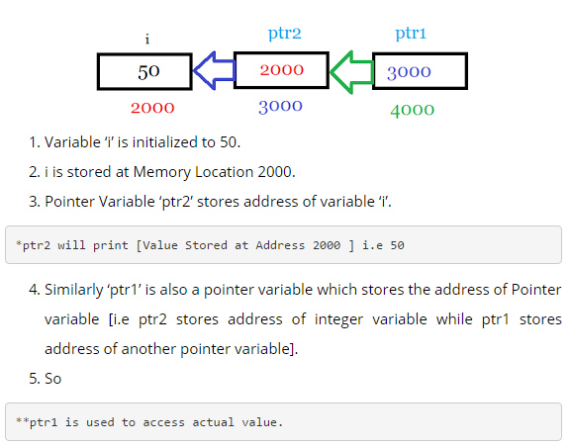
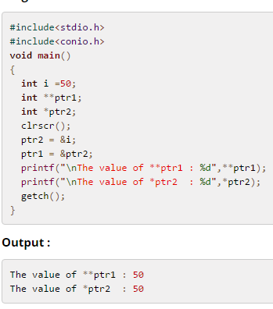
Example-Double Pointer
<number>
Department of CSE

Slide 52
Summary
Discussed about Pointer and its importance.
Discussed relationship between array and pointer
Discussed about Call-by-Reference and other places where pointers are needed for functions.
Discussed special pointers.
<number>
Department of CSE

Slide 53
References
Books/Materials
C Programming Course – Compiled HTML Help File
Brian W Kernighan, Dennis M Ritchie, “The C Programming Language”, 2nd Edition, PHI
Web
http://www.tutorialspoint.com/cprogramming/c_pointers.htm
http://www.cprogramming.com/tutorial/c/lesson6.html
<number>
Department of CSE

